Slide 1
Introduction to Automation

Slide 2
Version Control and Revision History
 | Name | Date
Prepared By | Manisha Mane | 01-Aug-2018
Reviewed By | Nisha Mendonsa | 02-Aug-2018
Approved By | Gauresh Gaitonde | 02-Aug-2018
Version No. | Date | Section Affected | Highlight of Changes
1.0.0 | 23-Mar-2017 | All | Original Version.
2.0.0 | 02-Aug-2018 | New topics added | Added Topics such as TestNG, Selenium with web driver

Slide 3








Iconic Representations.......
Test your Memory
Can you Solve?
Objective
Coffee Break
Queries
Recap
Need more Info
Brainstorm

Slide 4
Agenda
Manual Process
Automation Process
Working Architecture of Automation tool
Benefits of Automation Tool
Tools
Tools Utilized
Exercises

Slide 5
Manual Process
Responsibilities of a Tester
Writes Test cases
Review the Test cases
Application Under Test
Executes the Reviewed Test cases for ER = AR
Report the Defect in Defect Tracker
Development Team Takes it for rectification
ER = AR
ER <> AR
Plan for the Release

Slide 6
Automation Process
Responsibilities of a Tester
Identify the scenarios / Test condition – repeatedly tested
Check for the stability of the AUT
Application Under Test
Use the Tool to Record the Instructions and Execute
Report the Defect in Defect Tracker
Development Team Takes it for rectification
ER = AR
ER <> AR
Plan for the Release

Slide 7
Working Architecture of Automation tool
Tester
Instructions
( Transactions / Scripting)
Application Under Test
Tool
Learns the Objects / Controls with Properties
Creates the script in tool understandable format
Object Repository
( stores the Object Information for execution)
Reusable Scripts for Execution

Slide 8
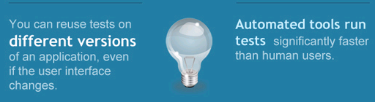
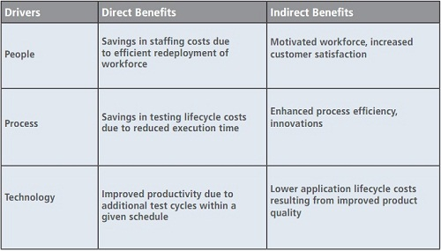
Benefits of Automation Tool
Reusable
Efficient
Effective
Accuracy
Reliable

Slide 9
Tools - Categorization
Functional Testing Tools
Business Scenarios are tested
Performance Testing Tools
Response Time
Effectiveness & Efficiency
Test Management Tools
Storage
Manual / Automation Testing
Load / Stress Testing

Slide 10
Tools Utilized
Vendor | Functional | Performance | Test Management
HP | Quick Test Professional ( QTP) | Loadrunner Performance Center | Quality Centre
IBM | Rational Functional Tester( RFT) | Rational Performance Tester ( RPT) | Rational Test Manager
Borland | Silk Test | Silk Performer | Silk Radar
Open Source Tools | Selenium Sahi | OPEN STA | Bugzilla

Slide 11
Exercises -1
Learn the Features of the Functional Tools mentioned in the Tools Utilized Slide (#8) under the following parameters
Parameters
Latest Version
Scripting Language
Object Learning Mechanism
Reusability of the Script
Kind of Applications Tested using the Tool
Compatible with other Tools or Not ( Script created can be stored / executed in other tools)
Compatible Test Management Tool

Slide 12
Exercises - 2
Learn the Features of the Performance Tools mentioned in the Tools Utilized Slide (#8) under the following parameters
Parameters
Latest Version
Scripting Language
Load / Stress Testing Feasibility
Compatibility with the Test Management Tool
Integration with the Functional Testing Tool
Components of the Tool & its Purpose

Slide 13
Exercises -3
Learn the Features of the Test Management Tools mentioned in the Tools Utilized Slide (#8) under the following parameters
Parameters
Latest Version
Compatibility with the Functional & Performance Testing Tool
Default Database used to Store the Information
Other compatible databases
Components of the Test Management Tool

Slide 14
Questions

